Slide 1
Econometrics 441|871 Time Series
How to do econometrics properly:
Some thoughts on significance, data mining and model selection

Slide 2
Time Series Models
Stationary
Non-Stationary
Univariate
Models
Multivariate Models
Single Endogenous: ARDL, GARCH
Many Endogenous: VAR, SVAR
Univariate
Deterministic Trends & Filters
Stochastic Trends: ARIMA(p,d,q)
Differencing
Only E(y_{t}): ARMA(p,q)
E(y_{t}) & Var(y_{t}): ARCH
Tests
Multivariate
Cointegration / VECM, ARDL
Model Selection

Slide 3
Introduction
We have studied the models that form the basis of much of modern time series econometrics
The goals are many, but can broadly be summarized as an attempt to find a valid empirical representation of the macroeconomy
Policy analysis and planning
Forecasting
We discussed many different features required for a “valid” model
Today we consider this more deeply in general
Think broadly in economics
Best application: Growth econometrics

Slide 4
Some questions
Should we care about statistical significance?
If so, how do we do it correctly?
When are these tests reliable as measures of “good models” or “strong results”?
The costs, risks, benefits and/or necessity of data mining

Slide 5
Should we care about statistical significance?
I assigned two suggested readings on this:
McCloskey (1999) – a quite unusually emotional letter that is published as an academic contribution
Hoover and Siegler (2008) – a considered, but also somewhat personal, response to McCloskey (and co-authors’) universe of contributions.
There are many additional interesting parts to this literature, in particular the main two contributions of McCloskey and Ziliak that Hoover and Siegler respond to, and McCloskey’s magnum opus:
McCloskey, D.N. and Ziliak, S.T., 1996. The standard error of regressions. Journal of economic literature, 34(1), pp.97-114.
Ziliak, S.T. and McCloskey, D.N., 2004. Size matters: the standard error of regressions in the American Economic Review. The Journal of Socio-Economics, 33(5), pp.527-546.
McCloskey, D.N. 1998. The Rhetoric of Economics (2nd ed.), Madison, WI: University of Wisconsin Press.

Slide 6
Deirdre McCloskey’s view
In my reading, the essential parts can be summarized as follows:
Econometric publications often confuse statistical significance with economic significance
A publishable paper typically needs statistically significant results to be accepted
This has led to bad science: a lot of effort on establishing statistically significant results that do not contribute to scientifically important economic knowledge

Slide 7
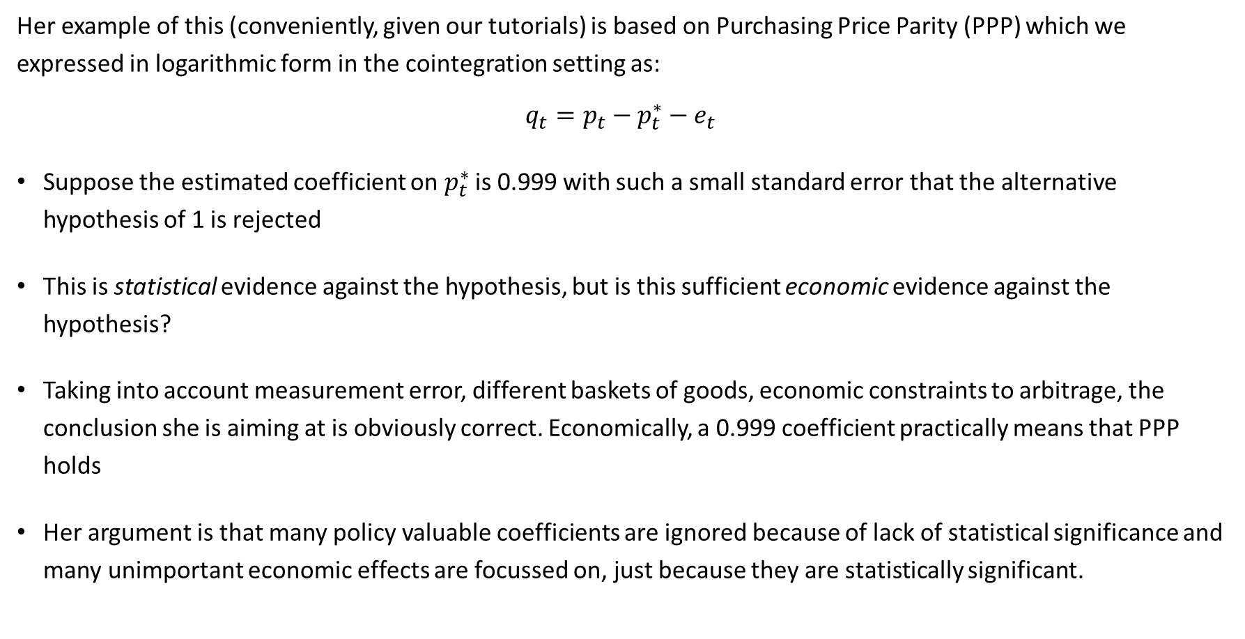
Deirdre McCloskey’s view
Her example of this (conveniently, given our tutorials) is based on Purchasing Price Parity (PPP) which we expressed in logarithmic form in the cointegration setting as:
$$q_{t}=p_{t}−p_{t}^{∗}−e_{t}$$
Suppose the estimated coefficient on $p_{t}^{∗}$ is 0.999 with such a small standard error that the alternative hypothesis of 1 is rejected
This is statistical evidence against the hypothesis, but is this sufficient economic evidence against the hypothesis?
Taking into account measurement error, different baskets of goods, economic constraints to arbitrage, the conclusion she is aiming at is obviously correct. Economically, a 0.999 coefficient practically means that PPP holds
Her argument is that many policy valuable coefficients are ignored because of lack of statistical significance and many unimportant economic effects are focussed on, just because they are statistically significant.

Slide 8
McCloskey and Ziliak
In two survey papers they analyse contributions to the American Economic Review (one of the top journals in the world) that employ regression analysis
182 papers in the 1980’s (McCloskey and Ziliak, 1996)
137 papers in the 1990’s (McCloskey and Ziliak, 2004)
Ask a battery of (19) questions, e.g.
Do the authors distinguish between statistical vs economic significance?
Do they evaluate the power of statistical tests?
Do they discuss the economic significance of the results?
Some findings (there are many)
They find that the problem (as they see it) has become worse:
In the 1980s, 70%, and in the 1990s, 82%, did not distinguish between statistical / economic significance
81% (1990s) of papers looked just for a “correct sign” and did not discuss the magnitude

Slide 9
Counter arguments to McCloskey and Co-authors
The negative responses to her claims are often very critical and excitingly aggressive.
These ones make strong logical points:
Hoover and Siegler (2008)
Agree: economic and statistical significance are distinct. Reject: economists systematically mistake the two or ignore economic significance
Argue against the methods they employ:
Questions they ask are arbitrary, deeply subjective, some redundant leading to double-counting of “problems”
Can provide no mapping from the analysed text to the conclusion reached, no way to measure consistency across the two surveys – hence, this is not a replicable study and itself bad science.

Slide 10
Counter arguments to McCloskey and Co-authors
The negative responses to her claims are often very critical and excitingly aggressive.
These ones make strong logical points:
Hoover and Siegler (2008)
Argues that significance testing is crucial
A measure of signal strength (signal-to-noise ratio)
Must be done correctly
An economically large but noisy signal must be treated with caution – it depends on the cost-benefits of committing either a Type 1 error (falsely rejecting a true null hypothesis) or a Type 2 error (mistakenly not rejecting a false null hypothesis).
Consider a lethal disease that can be cured with medication with unpleasant but non-fatal side-effects: H0: the patient has the disease
Type 1 error: falsely concluding that the patient does not have the disease leads to death
Type 2 error: falsely concluding that the patient does have the disease leads to unnecessary side-effects, but not death
If the disease has a low fatality rate, but the medication may also cause death, the trade-off changes. The same applies to any economic policy question, although it can be very difficult to specify the cost of a mistake
Shows that it is often used in exactly the same way in other sciences (contrary to McCloskey’s claims)

Slide 11
Counter arguments to McCloskey and Co-authors
Spanos (2008) writes a review of their book that summarizes their main arguments
Spanos, A., 2008. “Stephen T. Ziliak and Deirdre N. McCloskey's The cult of statistical significance: how the standard error costs us jobs, justice, and lives”. Ann Arbor (MI): The University of Michigan Press, 2008, xxiii+ 322 pp. Erasmus Journal for Philosophy and Economics, 1(1), pp.154- 164.
Deeply criticizes
Their reading of the history of statistics
Argues that some of their alternative are equivalent to significance testing
Their suggested approaches that side-steps a critical issue
One cannot argue for substantive results if a statistical model is not adequate, which requires specification testing.

Slide 12
My take:
Positive: McCloskey presents many valid issues with the rhetoric of economics which may be problematic for the scientific value of our contributions
It is worth taking note of and evaluating her criticisms when you do econometrics
For those that you find convincing, make sure you don’t do them
Negative: Her approach reads as a little too rhetorical itself
The language, analyses and selections seem tailored to sell what she is offering
Colourful and engaging language is not problematic if she is right, but she seems to be doing exactly what she is accusing everyone of:
Picking the interpretation to suit the cause
Not providing a replicable statistical basis for her empirical claims
I believe
Economic and statistical significance are both essential parts of any scientific contribution to economics
Statistical significance tests can be abused/misused in which case they are misleading and unscientific. Our next topic.

Slide 13
Some questions
Should we care about statistical significance?
If so, how do we do it correctly?
When are these tests reliable as measures of “good models” or “strong results”?
The costs, risks, benefits and/or necessity of data mining

Slide 14
Data Mining
Here we are talking about data mining via time series or other econometric methods
Machine learning on big data is a very different animal, but the risks are similar
Definition from Hoover and Perez (2000):
“‘Data mining’ refers to a broad class of activities that have in common, a search over different ways to process or package data statistically or econometrically with the purpose of making the final presentation meet certain design criteria.”
Spanos (2000) paraphrases Mayo (1996):
“the data are being utilized for double-duty, to arrive at a claim (a model, an estimator, a test or some other inference proposition) in such a way that the claim is constrained to satisfy some criteria (e.g., fit) but the same data is regarded as supplying evidence in support of the claim arrived at.”

Slide 15
Data Mining
Hoover and Perez (2000) identify three attitudes toward data mining:
It is bad: should be avoided, or if done, statistical tests should be adjusted to account for the repeated uses of the same data
It is bad but inevitable: given this, only robust models should be accepted (i.e. those that survive any data-mining attempt to destroy them)
It is essential: the only hope of uncovering the true DGP is by intelligently mining the data
Spanos (2000) makes a similar distinction between
Warranted (unproblematic) data mining
Unwarranted (problematic) data mining

Slide 16
Data Mining: the bad
Unwarranted data mining changes the true size of significance tests
Sampling variation may give spurious significant relationships
Seminal contribution:
Lovell (1983) presents an early simulation study summarized in Hoover and Perez (2000)
They characterize Lovell (1983) as a study to show that data mining is always bad
This happens when the validity of a model is only based on statistical “goodness-of-fit”, regardless of the method by which it is achieved
Lovell’s experiment
Key problem: selecting the correct variables that belong in the DGP
For a variety of simulated true DGP’s, ranging from
No relationship between dependent and explanatory variables, to
A true DGP with two explanatory variables
How do three model selection methods fare at uncovering the truth?
Step-wise regression – successively add explanatory variables
Max adjusted R-squared – select the best among all possible two variable regressions
Max-min t stat – select the model where the smallest of two t-stats is the largest across all the regressions

Slide 17
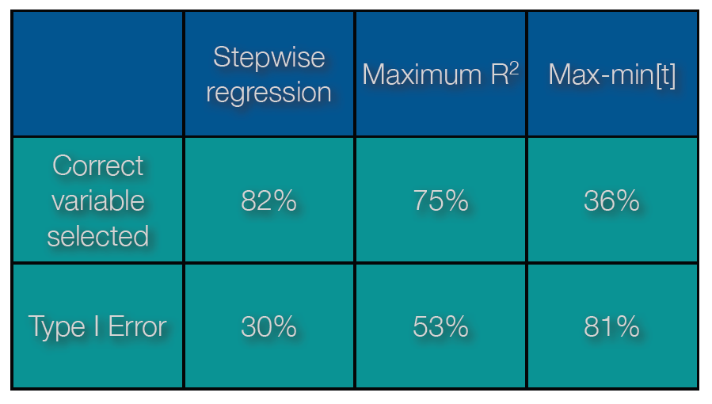
Results:
Actual
(when using a 5%
critical value)

Slide 18
Data Mining: the bad
Lovell’s findings:
All three model-selection procedures he tested did very poorly
Often found the wrong model
Actual sizes of nominal tests were very wrong (over optimistic – too often rejected a true null of zero)
The max-min t test approach is particularly misleading
His key suggestion to deal with this:
Due to sampling variation, some significant t-stats/High R-squared values are inevitable, some spuriously
Naïve data mining is extremely sensitive to spurious results
To avoid spurious selection, critical values (or significance levels) should be made stricter for the degree of search
To achieve a true 1% probability of type one error, one should use a much smaller nominal significance level (e.g. 0.01%) depending on how many times the data was reused in the specification search

Slide 19
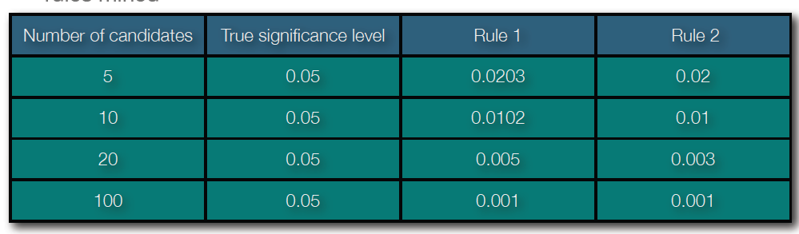
Suggestions:
Admit, describe iterations
Adjust test sizes for iterations
Lovell suggested two rules:
Hoover and Perez (2008) do not agree that this is the best approach. More below

Slide 20
Data Mining: the inevitable
The seminal contribution is from a Bayesian, Leamer (1978, 1983)
Main ideas (very roughly)
Presenting just the best model is misleading/unconvincing since every econometrician knows all other econometricians (except themselves, of course…) use unwarranted data-mining
Thus: present all possible alternative specifications
The only validly “significant” results are those that are robust against any possible alternative.
In practice: report the min and max of every coefficient in every sensible/feasible possible estimation variant. This is called “extreme bounds analysis”

Slide 21
Data Mining: the inevitable
Main Criticism of Extreme Bounds Analysis by Hoover and Perez (2000))
Again, due to sampling variation, there is no guarantee that the true DGP will be robust to all possible variants.
Expecting robustness against well-specified alternatives models is reasonable, but not against mis-specified alternatives:
When a model is mis-specified, all coefficients estimators are inconsistent and all test statistics are invalid, thus finding an estimate of a “true variable” that is insignificant or “the wrong sign” in a mis-specified model cannot necessarily be taken as evidence against it.
This mirrors the discussion we had with regards to unit root testing: even if a process is random-walk without drift, fitting a high enough polynomial in time (in this case, a mis-specification) will result in the rejection of difference stationarity.
Thus, while the Leamer approach might never give false positives (type 1 errors), it would almost certainly give many false negatives (type 2 errors)

Slide 22
Data Mining: the warranted (Spanos 2000)
Basic assumption: There is a true DGP although we can never know when we have uncovered it
“A good specification-search methodology is one in which the truth is likely to emerge as the search continues on more and more data”
Data-mining in some form is essential to uncover the DGP - “The only issue is whether any particular data mining scheme is a good one”
The general-to-specific approach (also called the LSE approach) to data mining argues that it is a necessary and useful approach to uncovering the true DGP
I have loosely referred to this approach in most of our empirical analyses
The central idea is that, when it is possible, to start with a General Unrestricted Model (GUM) of the DGP
A specification so flexible and general that the true DGP must be contained in the GUM
Given a GUM, all statistical tests are valid, and the GUM can be reduced in a philosophically and statistically defensible way to a parsimonious restricted model that encompasses all other models, which then represents the best estimate of the (local) DGP

Slide 23
Data Mining: the warranted
The general-to-specific approach is top-down proposed as an alternative to the bottom-up approach of Lovell (1983)
He started with small models and searched over them. I.e. most of the models were non-nested, so could not be compared “on equal footing”
Why should the general-to-specific approach work better?
The idea of the general-to-specific approach is to start with a large (almost certainly over-specified) model (the GUM) that nests all possible smaller models
Reducing from such a GUM is likely to work better, and several simulation studies have showed evidence that it does
The reason why it should work better is well articulated by Spanos (2000), by distinguishing between
Mis-specification tests, and
Primary/economic hypothesis tests

Slide 24
Mis-specification tests vs hypothesis tests
The main purpose of econometrics is to provide evidence for or against economic hypotheses. E.g.
Does PPP hold?
How large are the returns to education?
Is there evidence of collusion between firms?
In any estimated model, such empirical tests are only valid (unbiased/consistent) if the statistical model of the data is adequate, i.e. represents the true DGP underlying the economic processes
We test for the adequacy of a model (before we attempt to test for economic hypotheses) by using mis-specification tests.
How are they different?
An economic hypothesis tests asks whether there is evidence for or against certain claim in economic theory
A mis-specification tests asks whether the empirical model is statistically congruent with the data, whatever its economic content

Slide 25
The general-to-specific approach
Spanos (2000), Hoover and Perez (2000) and Hendry and co-authors all subscribe to this approach as a probabilistic reduction from a GUM to a parsimonious, encompassing empirical model on which economic hypotheses can be validly tested
The GUM is typically very over specified (poorly estimated coefficients), and hence cannot give sharp answers to questions of economic interest
This means reduction of the GUM to a more precise, smaller model is required
This is done by successive reductions of the model using mis-specification tests as pruning devices
As there may be different paths to reducing a model from GUM to final parsimonious form, this is not an obvious approach
Automated versions of the approach trace a large number of paths, which usually leads to many competing candidate final models
The candidates are then evaluated relative to each other via encompassing tests

Slide 26
The general-to-specific approach
This literature distinguishes between two very different concepts:
The statistical model of the data
The economic model that is tested against the data
For any test of an economic hypothesis on an estimated model to be valid, the estimated statistical model must be congruent with the data
The first step for an empirical researcher is therefore to construct a statistical model of the data generating process that is unrelated to the economic model of interest
In this school of thought, a model is considered (tentatively) to be adequate if it is congruent with the data in the following sense:
It yields results consistent with the measuring system (e.g. no negative unemployment rates)
Residuals are white noise and true innovations w.r.t. the measured variables
Coefficient estimates are stable w.r.t. the sample selection

Slide 27
The general-to-specific approach
An estimated model that does not have these basic characteristics (i.e. is not congruent) is obviously mis-specified, and cannot inform on any economic hypothesis (as all the coefficients are unreliable estimates of truth)
An estimated model that does have these characteristics (i.e. is congruent) might be valid, but still may be too uncertain (too over-specified, so that coefficient estimates are too imprecise) to give strong evidence on economic hypotheses
So the goal becomes to find the smallest model that is
Congruent with the data
Encompasses all other models – i.e. can explain the results of all other models

Slide 28
The general-to-specific approach
The ideal is obviously infeasible:
Estimate a model with all possible variables, interactions, lags, non-linearities
This must contain the true model, so we should be able to find it from there
But we do not have enough data for this ideal
The feasible strategy:
Estimate the largest feasible model
Test that it is congruent with the data with a battery of specification tests for the statistical model:
White noise residuals
Appropriately exogenous regressors
Stable estimated coefficients
Passing these tests does not prove congruency
Failing these tests rejects congruency – you need to start with an even larger model

Slide 29
The general-to-specific approach
The feasible strategy:
If the large model is congruent, start reducing
This protocol will lead to a set of smallest models that remains congruent
There may be many different paths – sampling variation means the “least significant” coefficient is not well identified
The most universal general-to-specific approach traces many paths of reduction (in terms of where one starts)
Test for encompassing of all terminal models

Slide 30
A test of the general-to-specific approach
Krolzig, H.M., 2003. General‐to‐specific model selection procedures for structural vector autoregressions. Oxford Bulletin of Economics and Statistics, 65, pp.769-801.
Monte Carlo exercise on I(0) SVAR
Construct SVAR/VAR from universe of 3 variables
PcGets is an automated implementation of the approach (only in OxMetrics last time I checked)

Slide 31
Counter argument:
Note that the analytic and Monte Carlo results of the general-to-specific approach are explicitly based on I(0) systems, although it is claimed that the method should give sensible answers in CI(1,1) systems as well
Lutkepohl (2007) argues that, especially in co-integration studies, general-to-specific modelling is not the procedure that is followed “globally” in a study, although it may be done on components of the modelling
Lütkepohl, H., 2007. General-to-specific or specific-to-general modelling? An opinion on current econometric terminology. Journal of Econometrics, 136(1), pp.319-324.

Slide 32
Lutkepohl (2007):
His description of general practice mirrors how we did co-integration analysis:
Step 1: test for unit roots individually
Recently, unit root tests can be done jointly
Step 2: among I(1) variables, investigate co-integrating relationships
He suggests that theoretically and practically, small subsystems should be considered first:
Bad small sample properties of large systems
“a better chance of finding interesting relationships”
Step 3: a small VAR/VEC model is used, reduced by the general-to-specific approach procedure
If the initial large model (as before) is not congruent with the data, even general-to-specific approach needs to augment
Spanos (2000), however, argues that adding lags is fundamentally different than adding variables to a system. Increasing the lag structure should not violate any of the rules
Step 4: extensions of the model are considered to check for robustness

Slide 33
My opinion
Lutkepohl is right that general-to-specific approach is not a good description of what econometricians actually do
But the general-to-specific idea is not about how things are typically done but a suggestion of how they should be done
The poor estimation of a large model is indeed a concern, and we have seen this in our explorations
However, he provides only concepts and ideas on what is often done without providing evidence that it works as well/better than a general-to-specific approach
Whether the general-to-specific approach works in a cointegration setting would have to be tested in a Monte Carlo “horse race” against other alternatives

Slide 34
A Problem with automated general-to-specific modelling
Last time I checked, it was only implemented by the originators in OxMetrics by Jurgen Doornik
OxMetrics is a proprietary econometrics program developed at Oxford
See http://www.doornik.com/
I like the agnostic, systematic approach, even if “done by hand” in smaller models than they suggest.

Slide 35
Model Selection
Even in the ideal setting, the general-to-specific reduction approach can lead to a variety of different final models
Depending on the sequence of reductions, different paths may lead to different final models
How do we choose between them?
The approach suggested by authors in the general-to-specific camp is to test for whether one (or more) models encompass the others
If model 1 encompasses model 2, it explains all the findings of model 2
If one model encompasses all the others, it is the preferred model to use to test economic hypotheses on.

Slide 36
Encompassing
Model selection is very complicated, and deeply depends on the situation
In the multiple equation VAR setting with an obvious set of variables, it is usually relatively simple – lag length is the only issue
When the choice of explanatory variables is at issue, it is much more complicated
Let’s construct a simple example to illustrate the idea

Slide 37
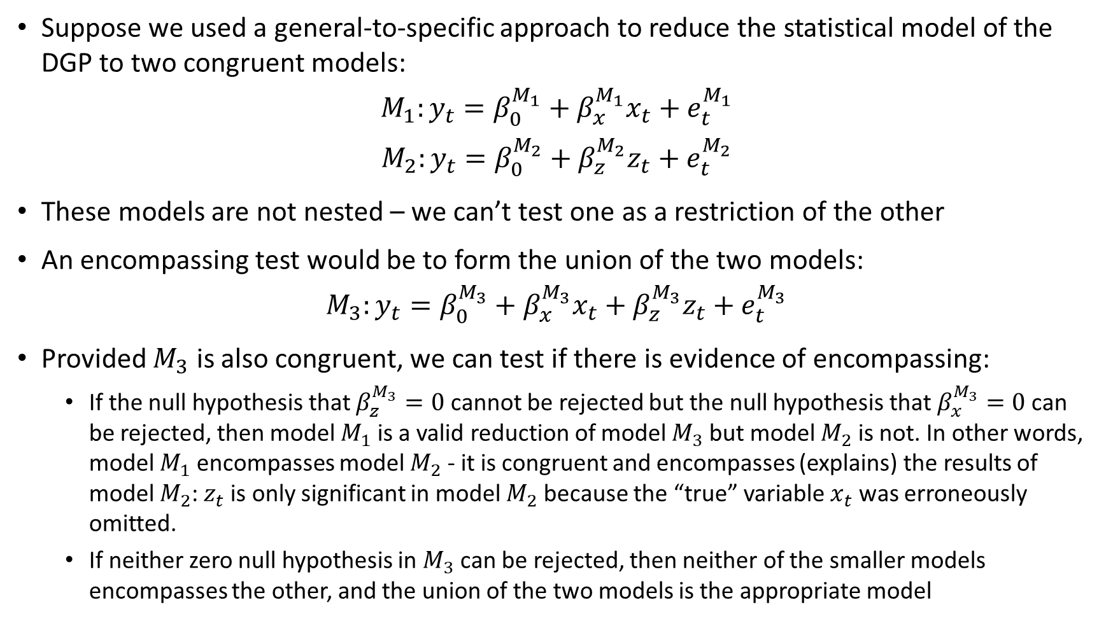
Encompassing
Suppose we used a general-to-specific approach to reduce the statistical model of the DGP to two congruent models:
$$M_{1}:y_{t}=β_{0}^{M_{1}}+β_{x}^{M_{1}}x_{t}+e_{t}^{M_{1}}$$
$$M_{2}:y_{t}=β_{0}^{M_{2}}+β_{z}^{M_{2}}z_{t}+e_{t}^{M_{2}}$$
These models are not nested – we can’t test one as a restriction of the other
An encompassing test would be to form the union of the two models:
$$M_{3}:y_{t}=β_{0}^{M_{3}}+β_{x}^{M_{3}}x_{t}+β_{z}^{M_{3}}z_{t}+e_{t}^{M_{3}}$$
Provided $M_{3}$ is also congruent, we can test if there is evidence of encompassing:
If the null hypothesis that $β_{z}^{M_{3}}=0$ cannot be rejected but the null hypothesis that $β_{x}^{M_{3}}=0$ can be rejected, then model $M_{1}$ is a valid reduction of model $M_{3}$ but model $M_{2}$ is not. In other words, model $M_{1}$ encompasses model $M_{2}$ - it is congruent and encompasses (explains) the results of model $M_{2}$: $z_{t}$ is only significant in model $M_{2}$ because the “true” variable $x_{t}$ was erroneously omitted.
If neither zero null hypothesis in $M_{3}$ can be rejected, then neither of the smaller models encompasses the other, and the union of the two models is the appropriate model

Slide 38
Summary
Doing econometrics well is difficult
So much endogeneity and simultaneity, so many options, so little data
Somewhere between an art and a science
We should strive to be as scientific in our production and reporting of our artworks as possible
One must take the risks very seriously
In one’s reading of other’s work as well as in one’s own
Read widely and critically on this topic and then form and continuously update your own best practice
None of the econometric high priests are right about everything, none of them are wrong about everything
Kennedy (2002) provides an amusing set of ten commandments for good data work that speak to a lot of issues. He gives very useful advice and pulls together a large variety of opinions and work on the issues
Some data-mining is inevitable
Do it systematically, carefully, honourably
Honestly report as much of the process as is feasible/important
Use solid statistical and economic reasoning to argue for your “best model” but give the readers the truth about its robustness/stability
Our job is (or should be) to agnostically test economic theories without preconceptions and our statistical practices should reflect this as best as possible

